Slide 1
Progressive Rails Apps
@mikegeyser
@RubyFuZa

Slide 2


@mikegeyser

Slide 3

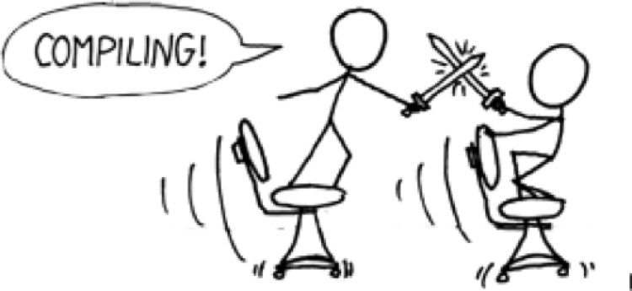
@mikegeyser

Slide 4

@mikegeyser

Slide 5
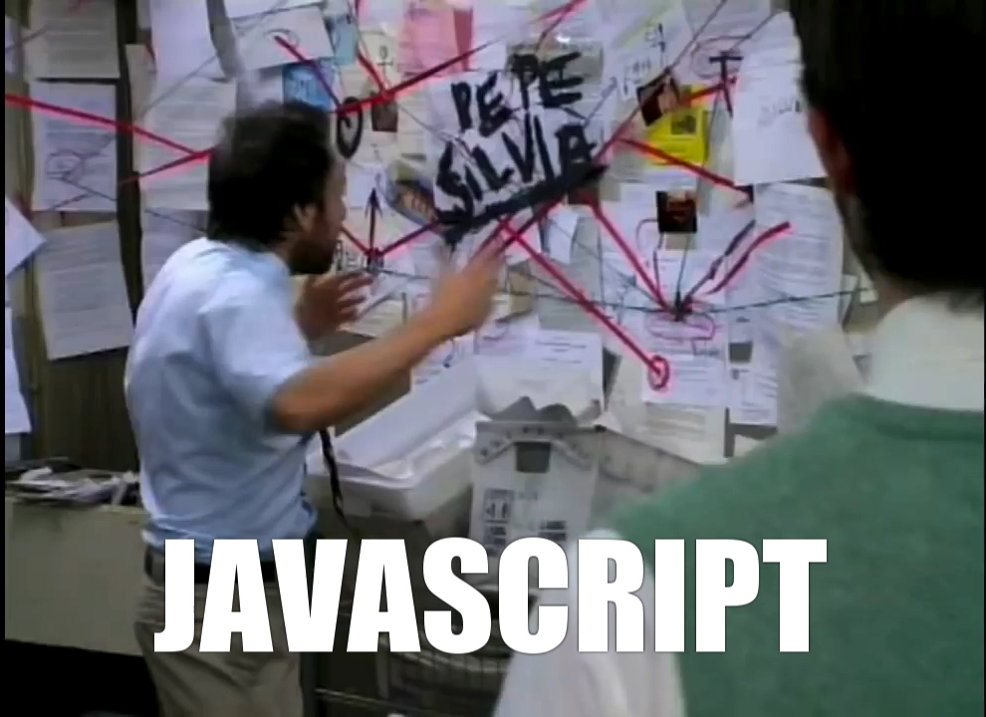

Slide 6
Progressive Rails Apps
@mikegeyser

Slide 7
@mikegeyser

Slide 8
@mikegeyser

Slide 9
@mikegeyser

Slide 11
Progressive Enhancement
@mikegeyser

Slide 12
Progressive Rails Apps
@mikegeyser

Slide 14


Slide 16
Progressive Rails Apps
@mikegeyser

Slide 17
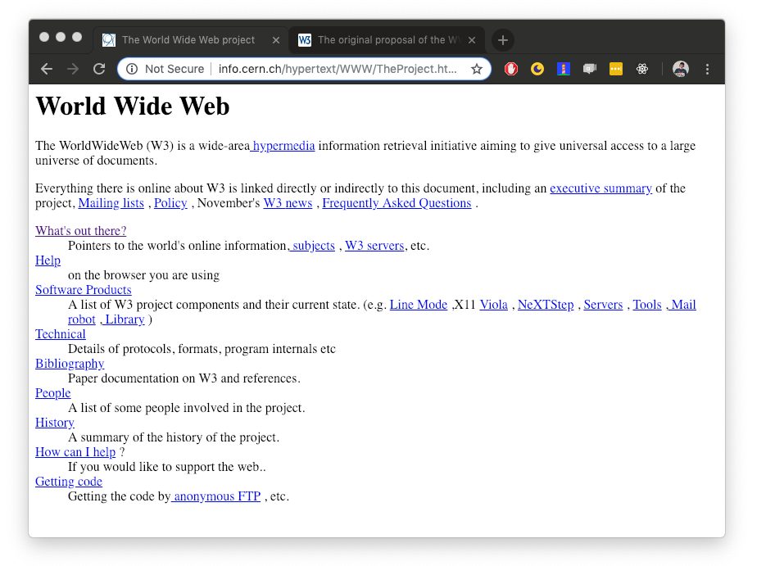
@mikegeyser

Slide 20
Ok... But how?
@mikegeyser

Slide 21

@mikegeyser

Slide 22
@mikegeyser

Slide 23



Service Worker
@mikegeyser

Slide 24


Slide 25
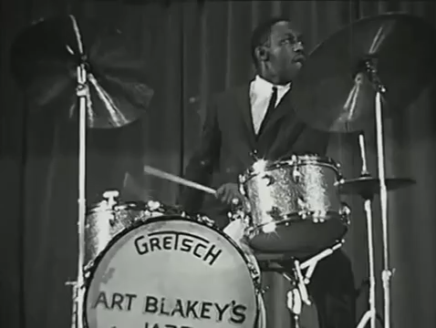
DEMO TIME

Slide 26
In summary
Improved performance
Network resilience
Progressive enhancement
@mikegeyser

Slide 27
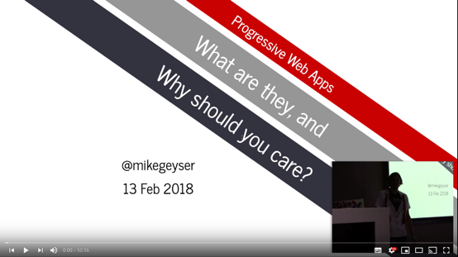
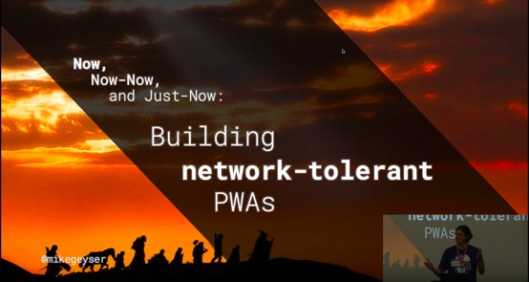

Questions?
@mikegeyser
https://goo.gl/geAwiw

